Slide 1

CS 370: Artificial Intelligence
Constraint Satisfaction Problems
Instructor: William DeMeo
Slides by Dan Klein and Pieter Abbeel University of California, Berkeley

Slide 2
CS 370: Artificial Intelligence
Constraint Satisfaction Problems
Instructor: William DeMeo
Slides by Dan Klein and Pieter Abbeel provided courtesy of ai.berkeley.edu

Slide 3
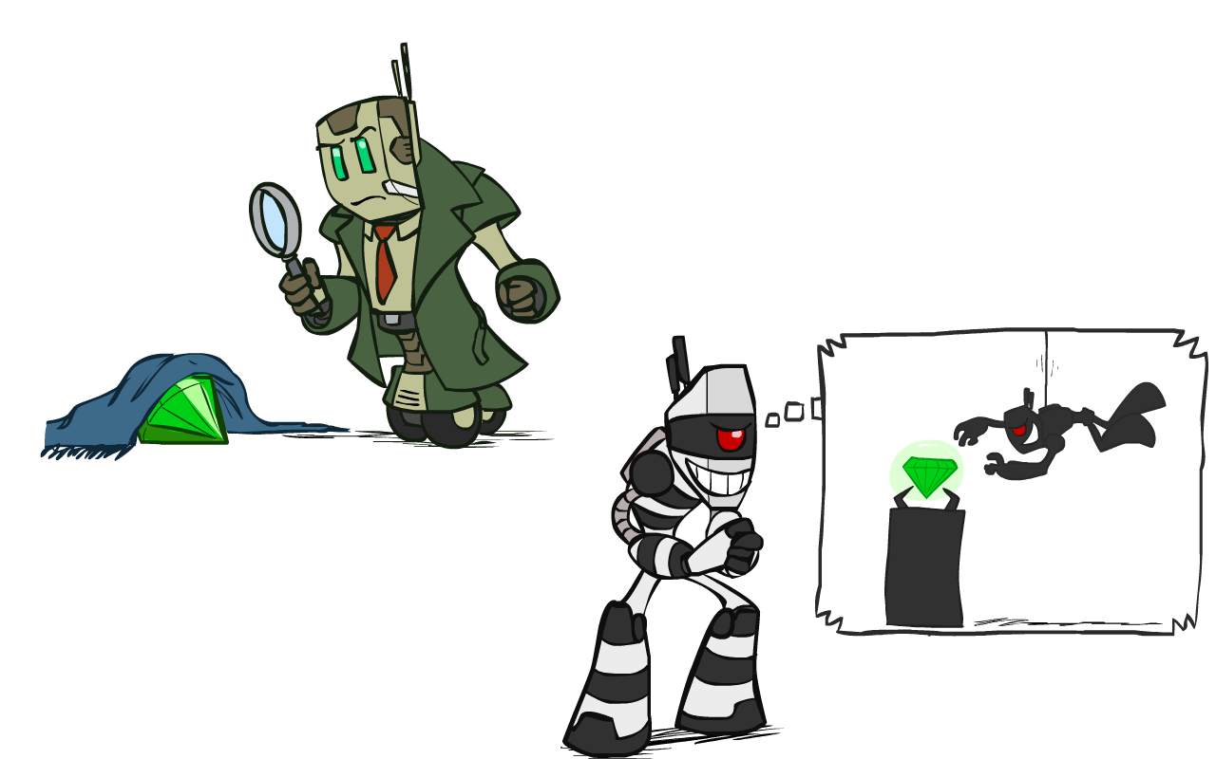
What is Search For?
Assumptions about the world: a single agent, deterministic actions, fully observed state, discrete state space
Planning: sequences of actions
The path to the goal is the important thing
Paths have various costs, depths
Heuristics give problem-specific guidance
Identification: assignments to variables
The goal itself is important, not the path
All paths at the same depth (for some formulations)
CSPs are a specialized class of identification problems

Slide 4

Constraint Satisfaction Problems

Slide 5

Constraint Satisfaction Problems
Standard search problems:
State is a “black box”: arbitrary data structure
Goal test can be any function over states
Successor function can also be anything
Constraint satisfaction problems (CSPs):
A special subset of search problems
State is defined by variables X_{i} with values from a domain D (sometimes D depends on i)
Goal test is a set of constraints specifying allowable combinations of values for subsets of variables
Simple example of a formal representation language
Allows useful general-purpose algorithms with more power than standard search algorithms

Slide 6
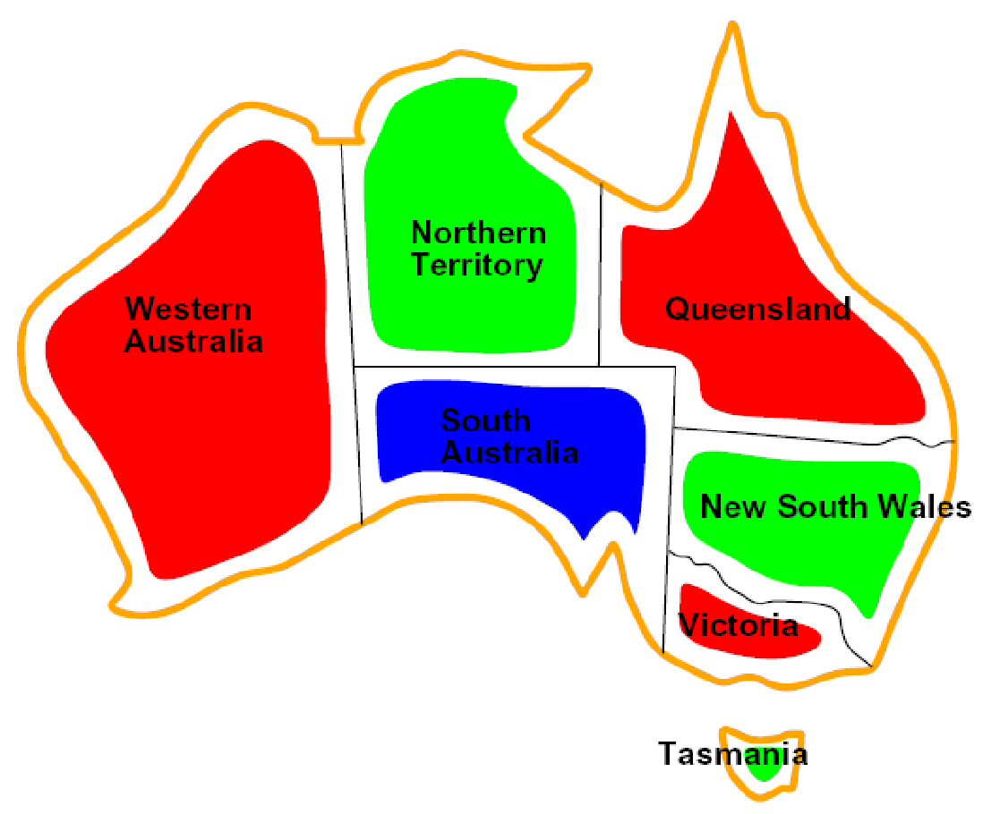
CSP Examples

Slide 7


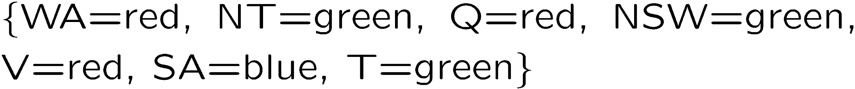
Example: Map Coloring
Variables:
Domain:
Constraints: adjacent regions must have different colors
Solutions are assignments satisfying all constraints, e.g.:
Implicit:
Explicit:

Slide 8

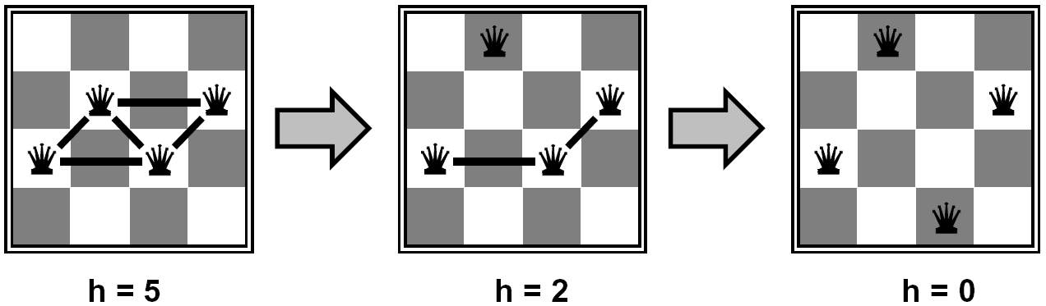
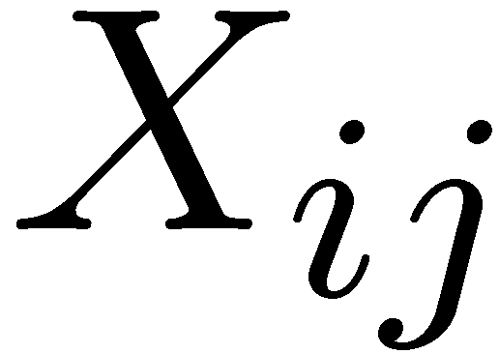

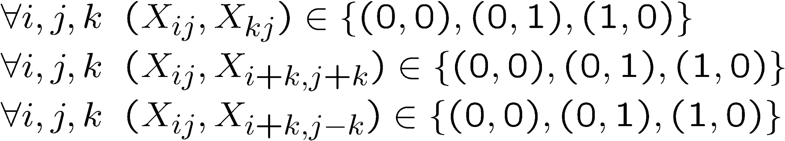
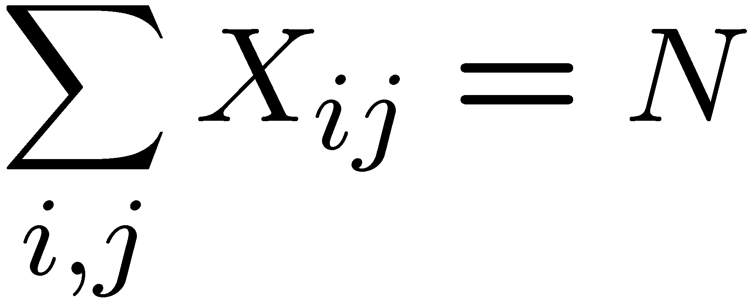
Example: N-Queens
Formulation 1:
Variables:
Domain:
Constraints

Slide 9







Example: N-Queens
Formulation 2:
Variables:
Domain:
Constraints:
Implicit:
Explicit:

Slide 10
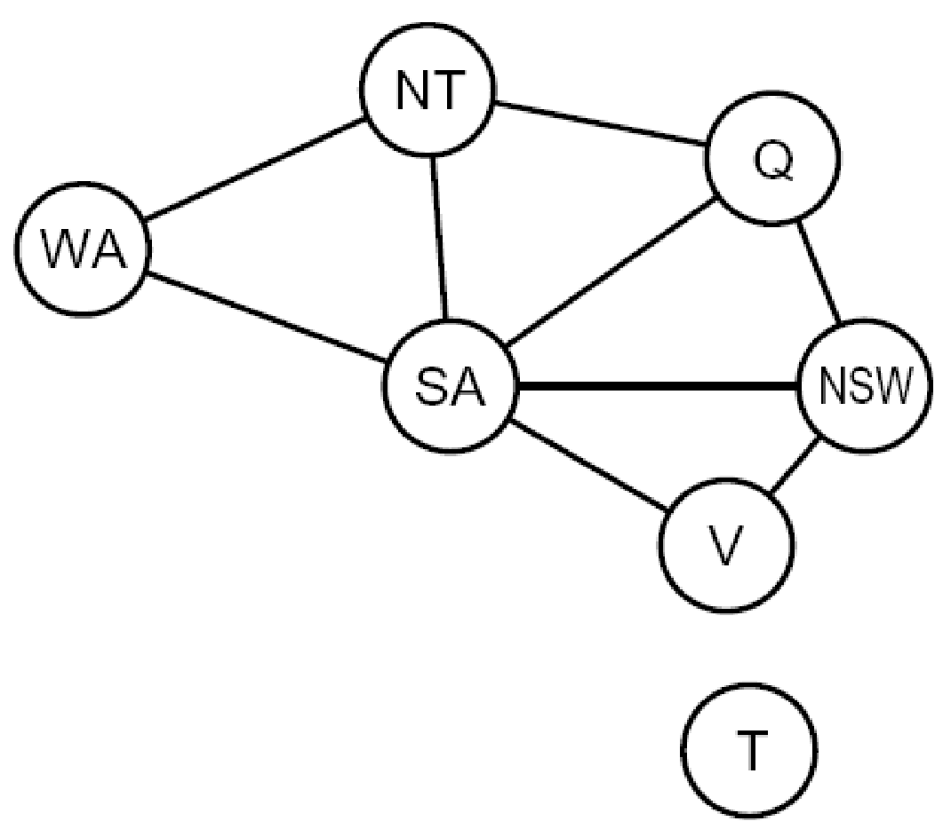
Constraint Graphs

Slide 11
Constraint Graphs
Binary CSP: each constraint relates (at most) two variables
Binary constraint graph: nodes are variables, arcs show constraints
General-purpose CSP algorithms use the graph structure to speed up search. E.g., Tasmania is an independent subproblem!
[Demo: CSP applet (made available by aispace.org) -- n-queens]
Notes:
Demo:
Run constraint.jar or constraint.exe, load the 5 queens problem.
Demo is just showing the n-queens applet as illustration of constraint graph, but later in lecture we’ll interact with the applet.
aispace.org will have the latest version

Slide 12
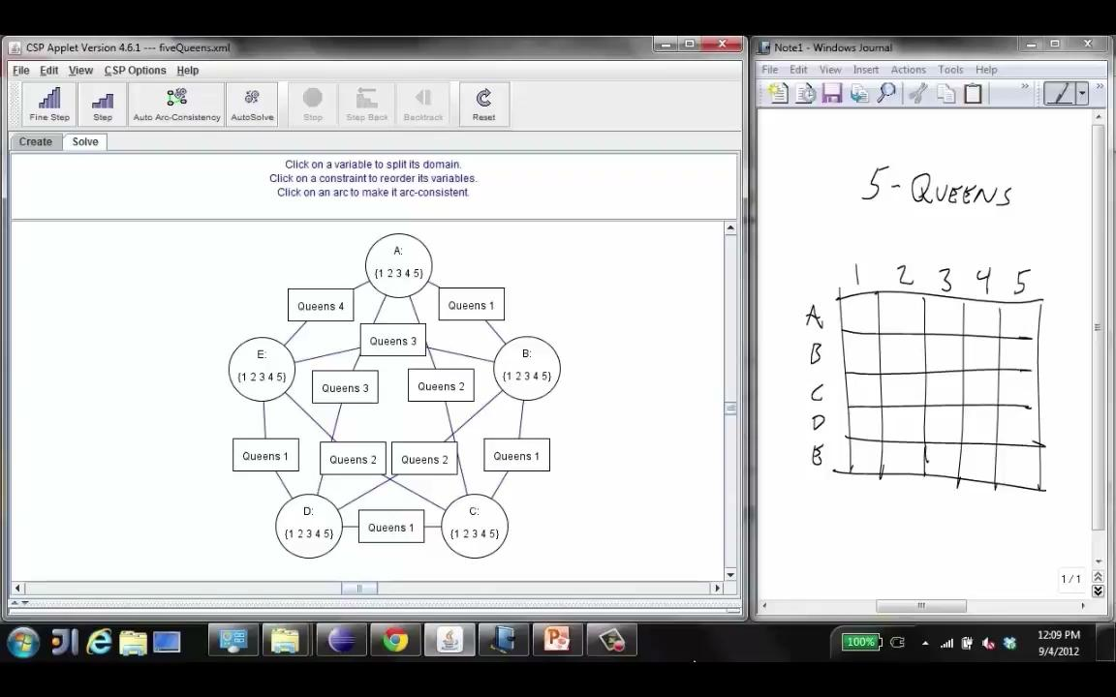
Screenshot of Demo N-Queens
Notes:
Note: the n-queens demo is used later as a demo; at this stage in lecture just the above is shown and talked about without engaging in any interaction with the applet.

Slide 13

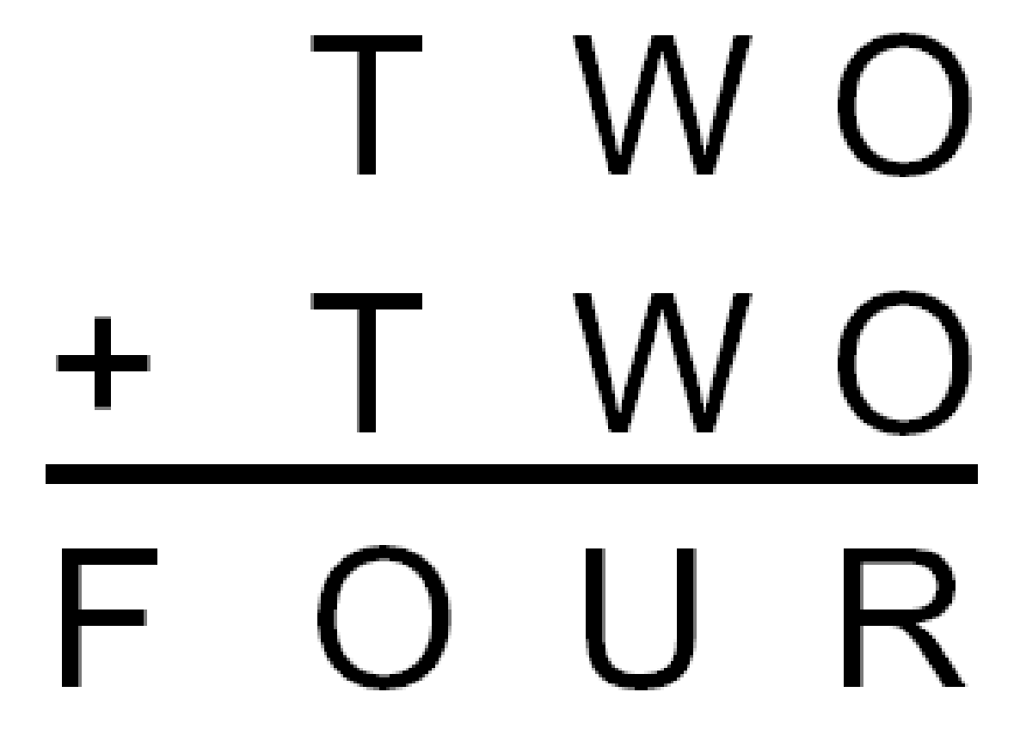
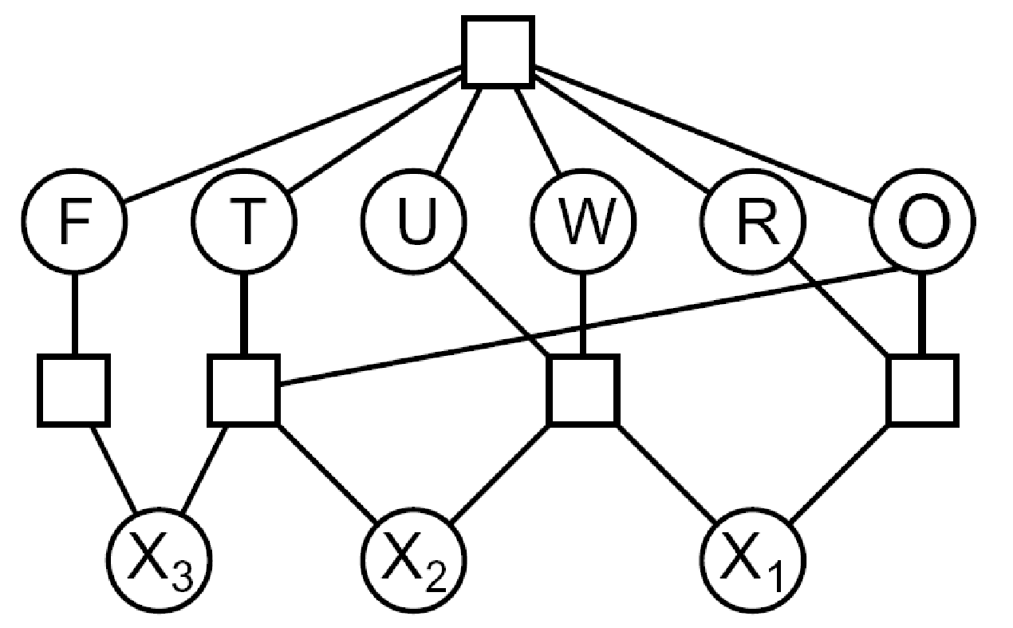

Example: Cryptarithmetic
Variables:
Domain:
Constraints:
Notes:
0=7, R=4, W=6, U=2, T=8, F=1; 867 + 867 = 1734

Slide 14
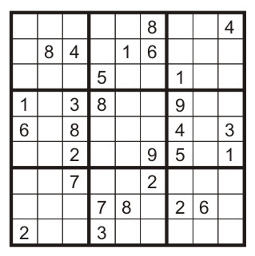
Example: Sudoku
Variables:
Each (open) square
Domain:
{1,2,…,9}
Constraints:
9-way alldiff for each column
9-way alldiff for each row
9-way alldiff for each region
(or can have a bunch of pairwise inequality constraints)

Slide 15


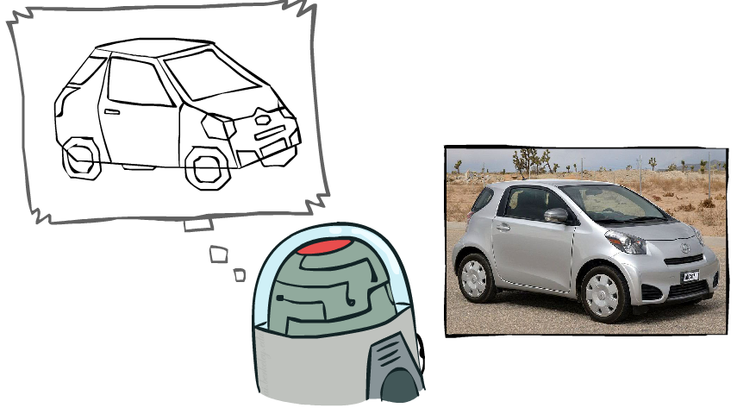
Example: The Waltz Algorithm
The Waltz algorithm is for interpreting line drawings of solid polyhedra as 3D objects
An early example of an AI computation posed as a CSP
?
Approach:
Each intersection is a variable
Adjacent intersections impose constraints on each other
Solutions are physically realizable 3D interpretations

Slide 16

Varieties of CSPs and Constraints

Slide 17

Varieties of CSPs
Discrete Variables
Finite domains
Size d means O(d^{n}) complete assignments
E.g., Boolean CSPs, including Boolean satisfiability (NP-complete)
Infinite domains (integers, strings, etc.)
E.g., job scheduling, variables are start/end times for each job
Linear constraints solvable, nonlinear undecidable
Continuous variables
E.g., start/end times for Hubble Telescope observations
Linear constraints solvable in polynomial time by LP methods (see cs170 for a bit of this theory)

Slide 18


Varieties of Constraints
Varieties of Constraints
Unary constraints involve a single variable (equivalent to reducing domains), e.g.:
Binary constraints involve pairs of variables, e.g.:
Higher-order constraints involve 3 or more variables:
e.g., cryptarithmetic column constraints
Preferences (soft constraints):
E.g., red is better than green
Often representable by a cost for each variable assignment
Gives constrained optimization problems
(We’ll ignore these until we get to Bayes’ nets)

Slide 19
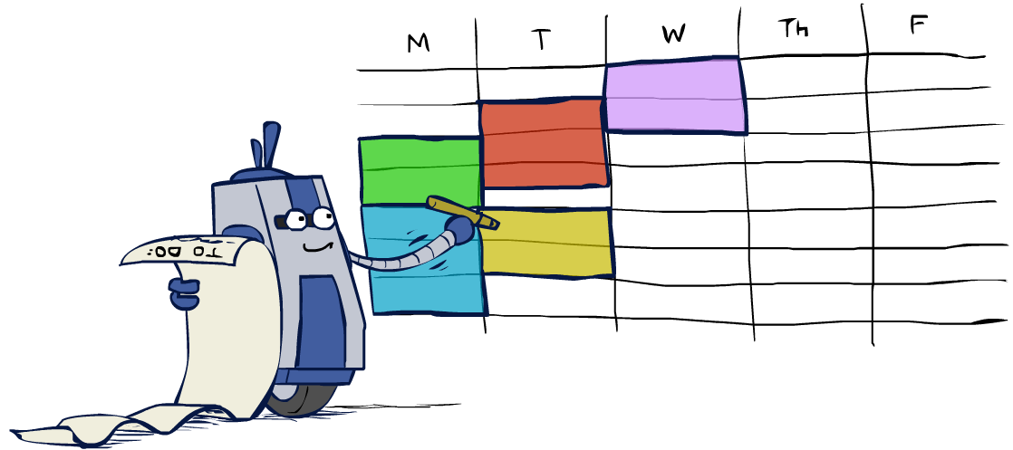
Real-World CSPs
Scheduling problems: e.g., when can we all meet?
Timetabling problems: e.g., which class is offered when and where?
Assignment problems: e.g., who teaches what class
Hardware configuration
Transportation scheduling
Factory scheduling
Circuit layout
Fault diagnosis
… lots more!
Many real-world problems involve real-valued variables…

Slide 20

Solving CSPs

Slide 21
Standard Search Formulation
Standard search formulation of CSPs
States defined by the values assigned so far (partial assignments)
Initial state: the empty assignment, {}
Successor function: assign a value to an unassigned variable
Goal test: the current assignment is complete and satisfies all constraints
We’ll start with the straightforward, naïve approach, then improve it

Slide 22
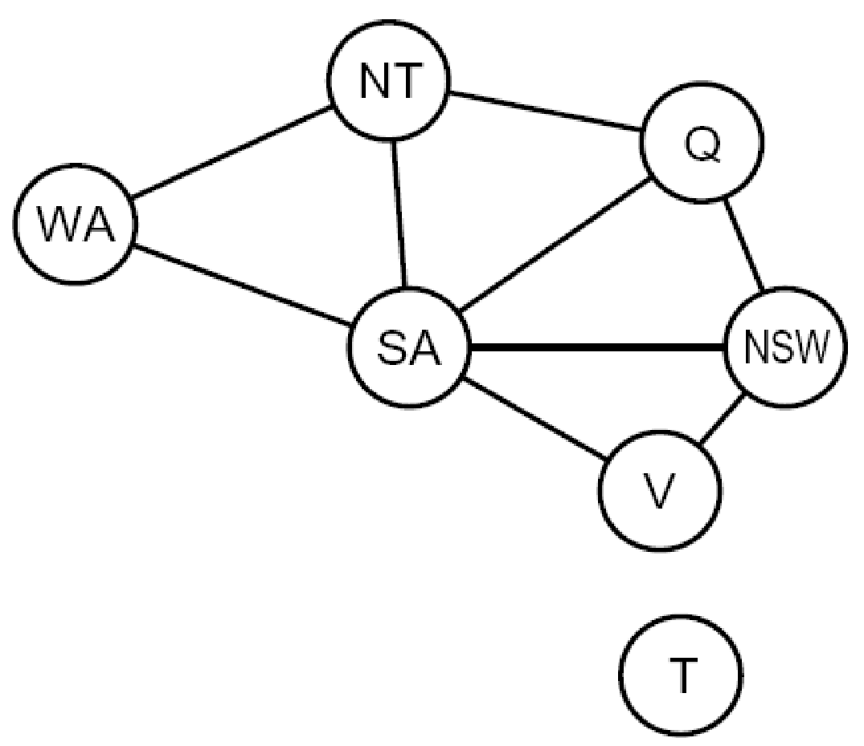
Search Methods
What would BFS do?
What would DFS do?
What problems does naïve search have?
[Demo: coloring -- dfs]
Notes:
Demo:
CS188 javascript demos -> source -> exercises -> csps -> CSPs demos -> CSPs demos.html
Settings:
Graph = Simple
Algorithm = Naïve Search
Ordering = None
Filtering = None

Slide 23
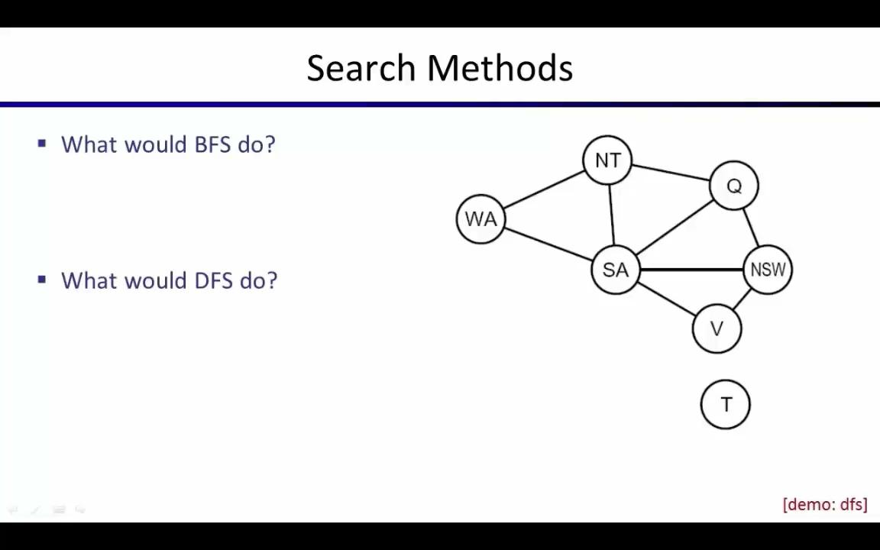
Video of Demo Coloring -- DFS

Slide 24

Backtracking Search

Slide 25
Backtracking Search
Backtracking search is the basic uninformed algorithm for solving CSPs
Idea 1: One variable at a time
Variable assignments are commutative, so fix ordering
I.e., [WA = red then NT = green] same as [NT = green then WA = red]
Only need to consider assignments to a single variable at each step
Idea 2: Check constraints as you go
I.e. consider only values which do not conflict with previous assignments
Might have to do some computation to check the constraints
“Incremental goal test”
Depth-first search with these two improvements
is called backtracking search (not the best name)
Can solve n-queens for n ≈ 25

Slide 26
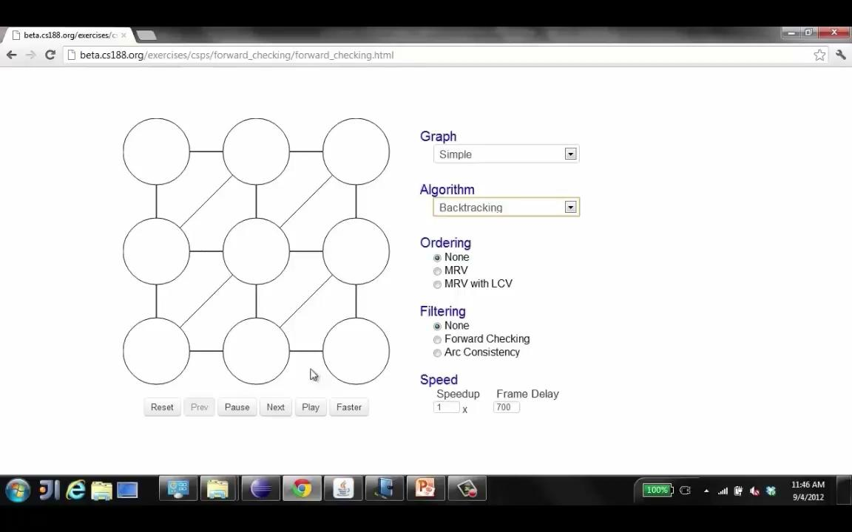
Video of Demo Coloring – Backtracking

Slide 27

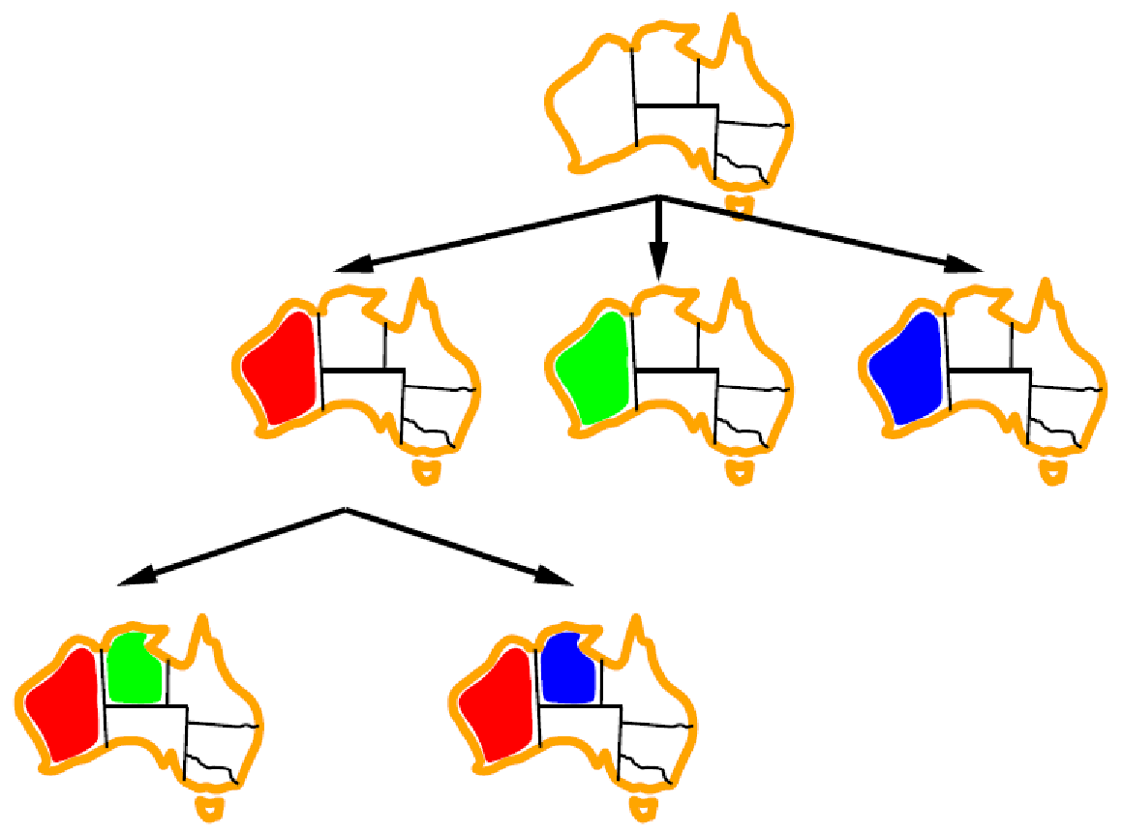
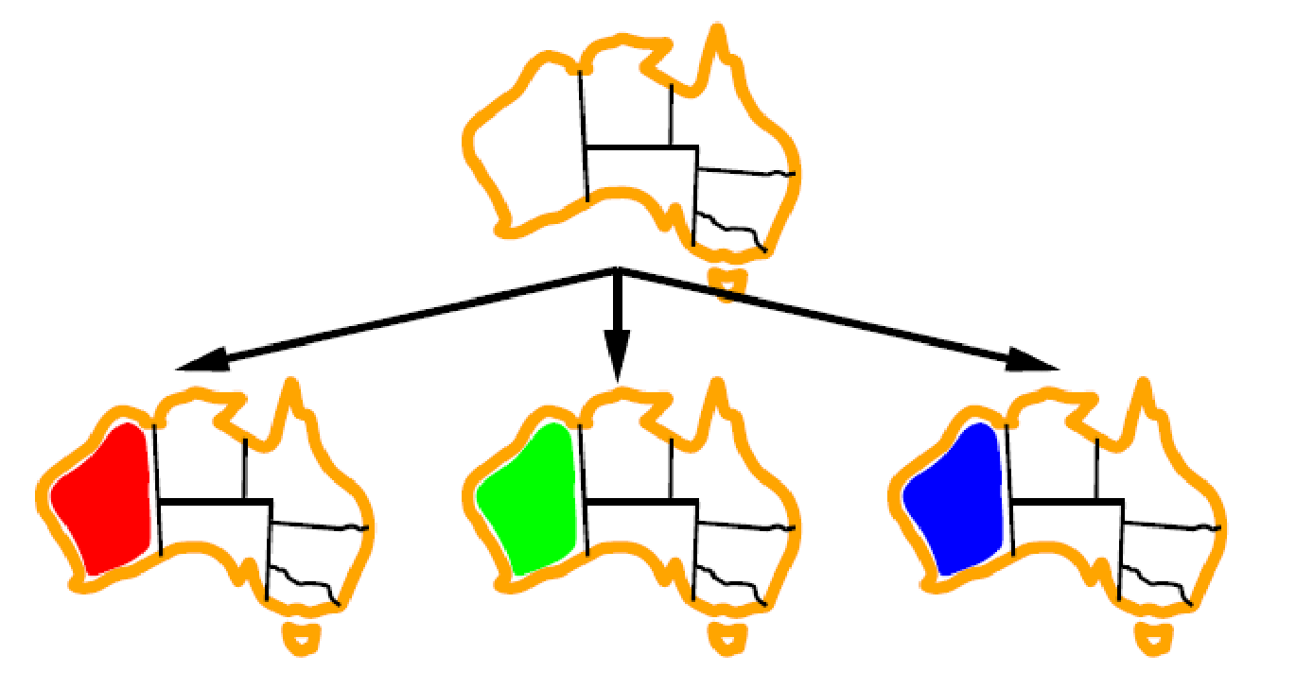
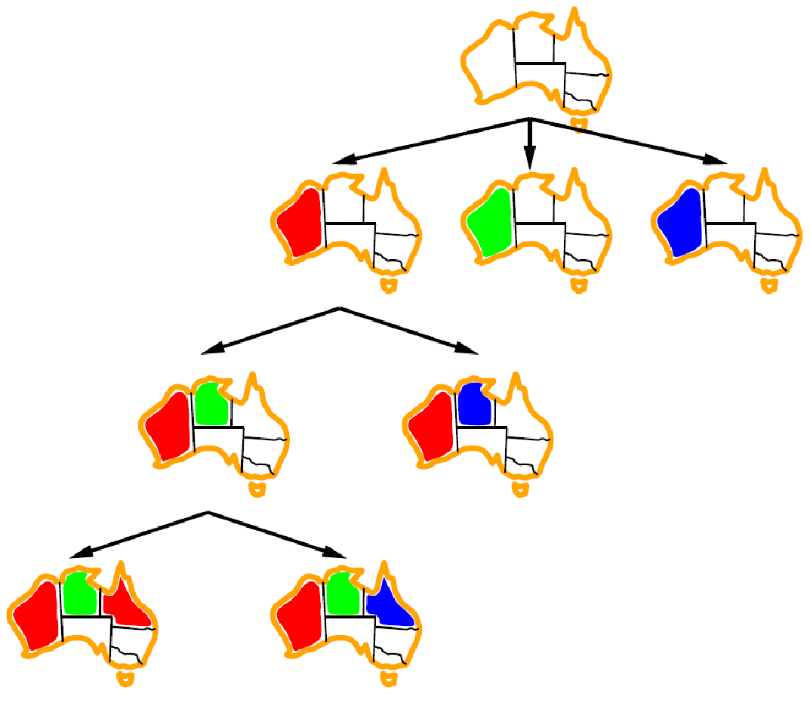
Backtracking Example

Slide 28
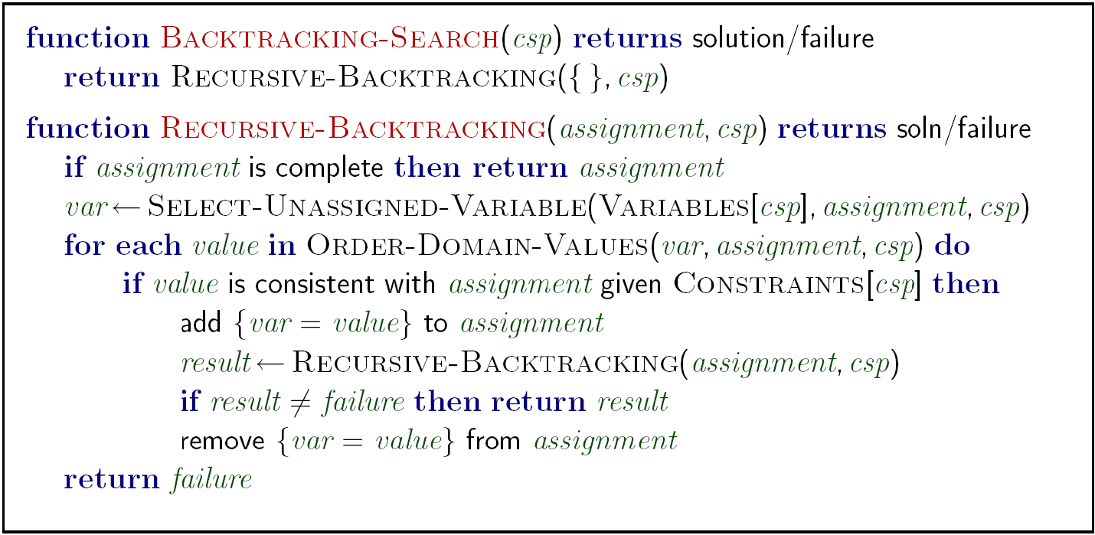
Backtracking Search
Backtracking = DFS + variable-ordering + fail-on-violation
What are the choice points?
[Demo: coloring -- backtracking]
Notes:
Demo:
CS188 javascript demos -> source -> exercises -> csps -> CSPs demos -> CSPs demos.html
Settings:
Graph = Simple
Algorithm = Backtracking
Ordering = None
Filtering = None

Slide 29

Improving Backtracking
General-purpose ideas give huge gains in speed
Ordering:
Which variable should be assigned next?
In what order should its values be tried?
Filtering: Can we detect inevitable failure early?
Structure: Can we exploit the problem structure?

Slide 30

Filtering
Notes:
Filtering is about ruling out candidates
for variables you haven't yet assigned

Slide 31
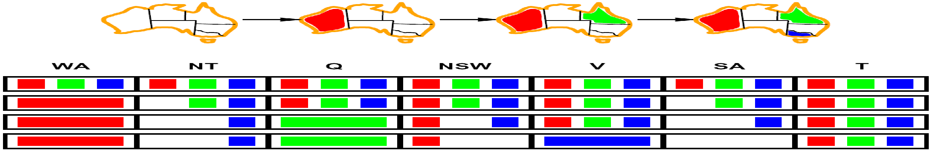
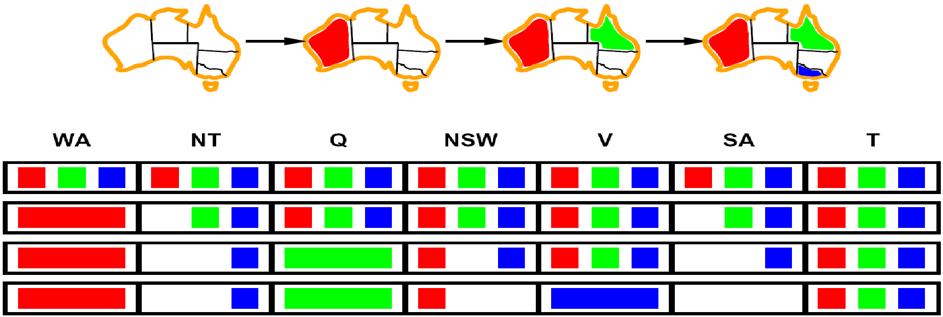
Filtering: Forward Checking
Filtering: Keep track of domains for unassigned variables and cross off bad options
Forward checking: Cross off values that violate a constraint when added to the existing assignment
WA
NT
Q
SA
NSW
V
[Demo: coloring -- forward checking]
Notes:
For each variable we keep a cloud of values that are so far okay for that variable.
If a domain every becomes empty, then we have no path to a solution so backtrack.
Demo:
CS188 javascript demos -> source -> exercises -> csps -> CSPs demos -> CSPs demos.html
Settings:
Graph = Simple
Algorithm = Backtracking
Ordering = None
Filtering = Forward Checking

Slide 32
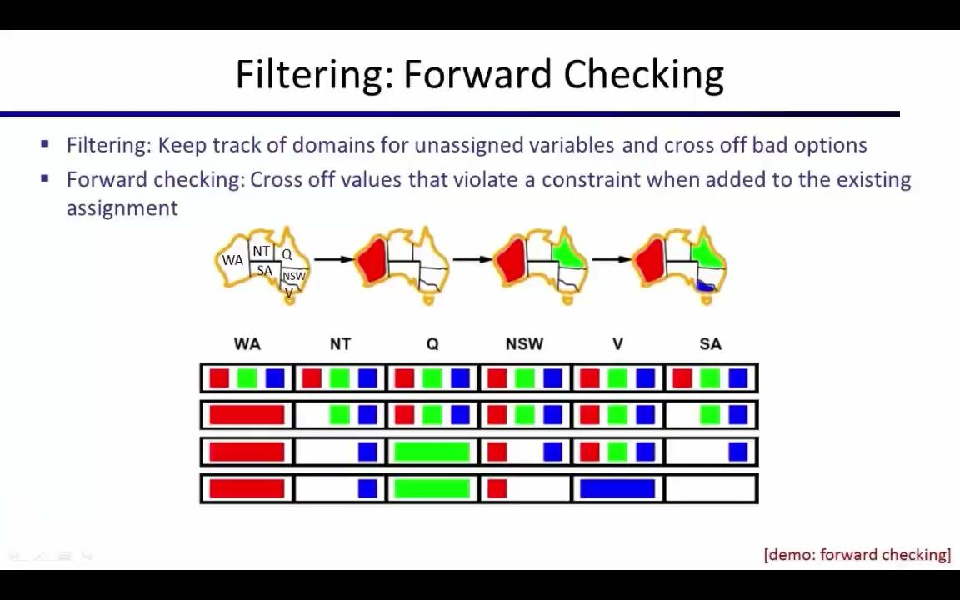
Video of Demo Coloring – Backtracking with Forward Checking

Slide 33
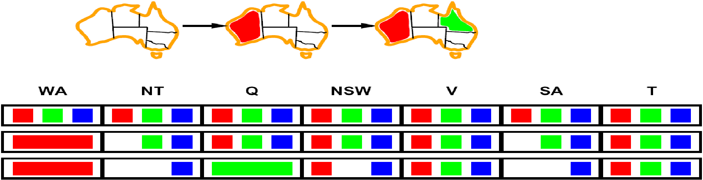
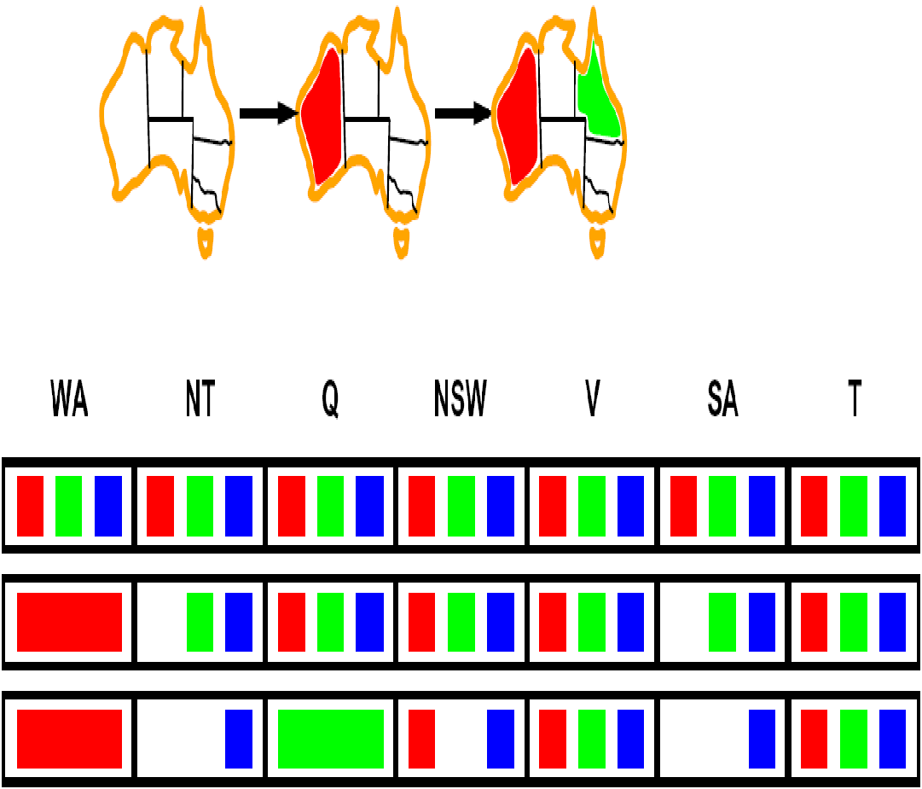
Filtering: Constraint Propagation
Forward checking propagates information from assigned to unassigned variables, but doesn't provide early detection for all failures:
NT and SA cannot both be blue!
Why didn’t we detect this yet?
Constraint propagation: reason from constraint to constraint
NT
Q
WA
SA
NSW
V
Notes:
Forward checking doesn't look very far ahead.
It does not provide early detection of potential conflicts for unassigned variables.

Slide 34
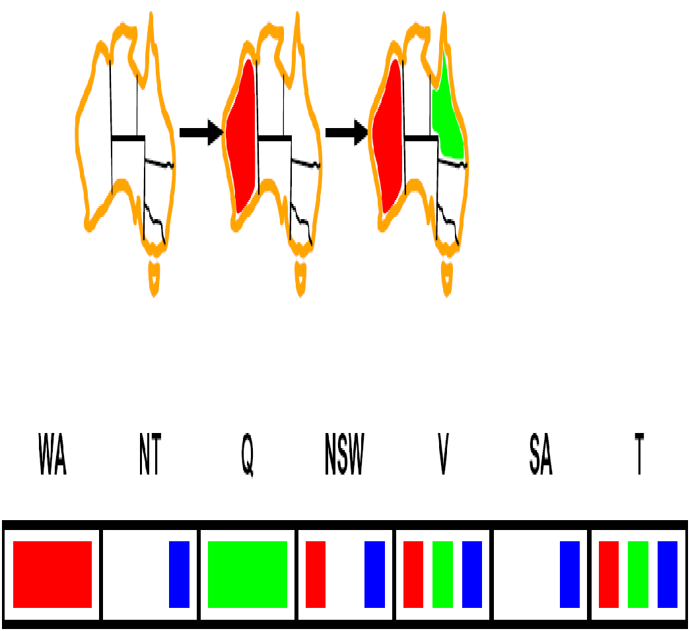
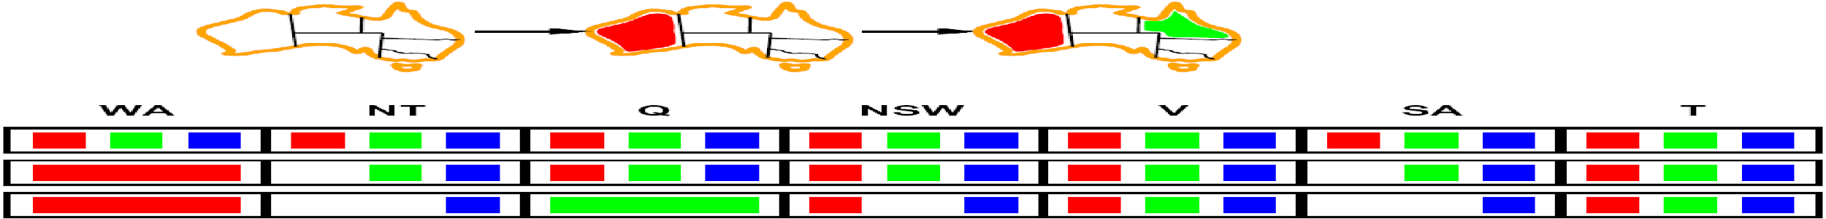


Consistency of A Single Arc
An arc X → Y is consistent iff for every x in the tail there is some y in the head which could be assigned without violating a constraint
Forward checking: Enforcing consistency of arcs pointing to each new assignment
NT
Q
WA
SA
NSW
V
Delete from the tail!
Notes:
What does it mean to check a constraint?
An arc is a directed edge. A directed constraint edge.
Intuitively, an arc is consistent if there's no constraint violation along that arc.
Formally, an arc is consistent if for every value in the tail, there is some value in the head that could be assigned without violating a constraint.
If an arc is not consistent, we can make it consistent by removing a value from the tail variable.
Constraints are rules and the algorithms are like police.
If there's anything in the tail that is guaranteed to fail, given what's left in the head, delete it!

Slide 35

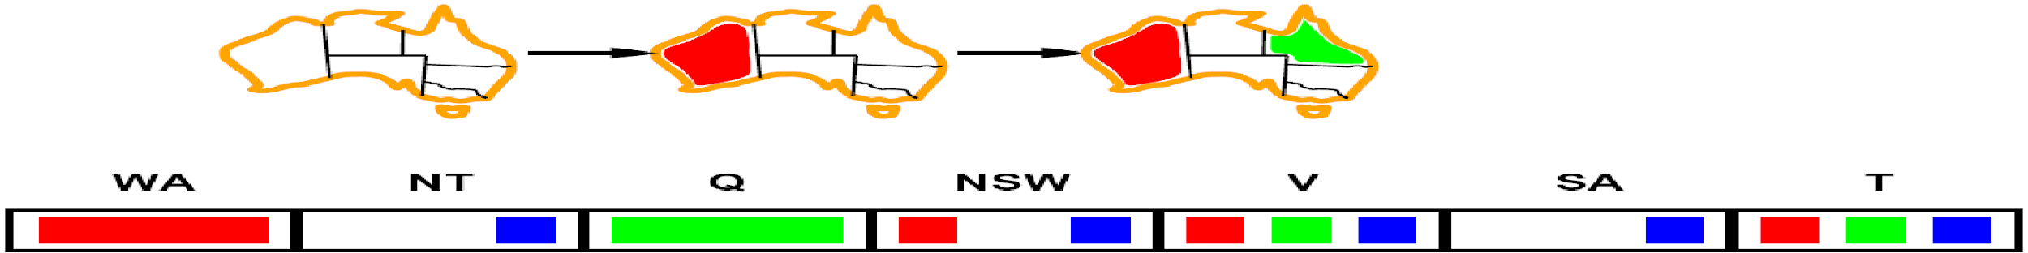
Arc Consistency of an Entire CSP
A simple form of propagation makes sure all arcs are consistent:
Important: If X loses a value, neighbors of X need to be rechecked!
Arc consistency detects failure earlier than forward checking
Can be run as a preprocessor or after each assignment
What’s the downside of enforcing arc consistency?
NT
Q
WA
SA
NSW
V
Remember: Delete from the tail!
Notes:
If, after assigning a value to a variable, we just consider the arcs pointing into that variable
and if we enforce arc consistency, then we recover forward checking.
But now we will go further and check constraints on other pairs of variables (arcs).
Notice what happens when we delete blue from NSW.
We must recheck all arcs going into NSW.
For example, green must now be removed from V.
This example shows that WA: Red and Q: Green doesn't work and we catch it pretty early, unlike Forward Checking.
The downside is bad run time... does it even converge?
Does this remind you of A* search? We do a lot of work on every node to see what to do next.

Slide 36
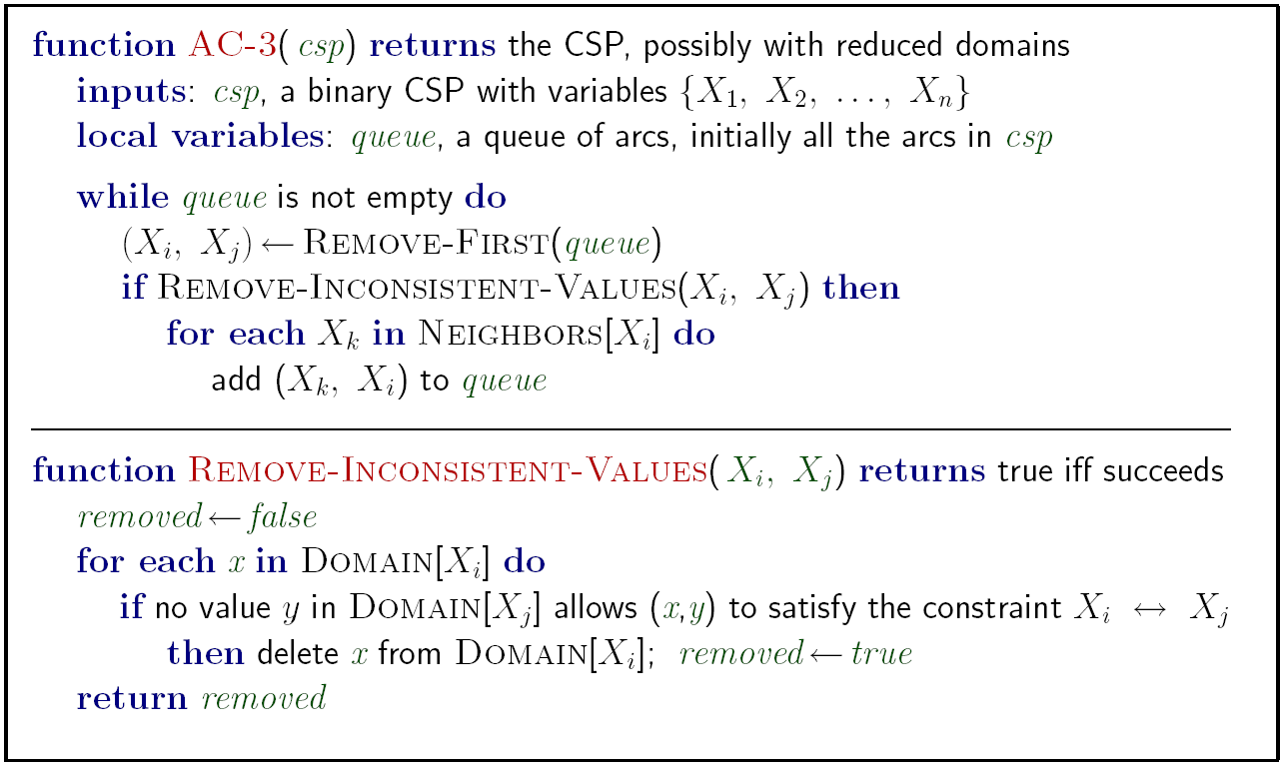
Enforcing Arc Consistency in a CSP
Runtime: O(n²d³), can be reduced to O(n²d²)
… but detecting all possible future problems is NP-hard – why?
[Demo: CSP applet (made available by aispace.org) -- n-queens]
Notes:
Notice, if you remove inconsistent value, you throw a bunch of stuff back into the que in order to recheck.
So maybe this won't converge... but it does... why?
Because we only put stuff back on the queue when we delete something! ...so domain is getting smaller.
Auto-consistency (note initially nothing gets deleted/pruned since there are consistent options for all constraints for initial variable domains)
Flashes whenever something needs to be re-checked

Slide 37
Video of Demo Arc Consistency – CSP Applet – n Queens

Slide 38
Limitations of Arc Consistency
After enforcing arc consistency:
Can have one solution left
Can have multiple solutions left
Can have no solutions left (and not know it)
Arc consistency still runs inside a backtracking search!
What went wrong here?
[Demo: coloring -- forward checking]
[Demo: coloring -- arc consistency]
Notes:
What went wrong is that we had three nodes and arc consistency only considers pairs.
Demo:
CS188 javascript demos -> source -> exercises -> csps -> CSPs demos -> CSPs demos.html
Settings:
Graph = Complex
Algorithm = Backtracking
Ordering = None
Filtering = Forward Checking (first) / Arc Consistency (second)

Slide 39
Video of Demo Coloring – Backtracking with Forward Checking – Complex Graph
https://inst.eecs.berkeley.edu/~cs188/fa19/assets/demos/csp/csp_demos.html

Slide 40
Video of Demo Coloring – Backtracking with Arc Consistency – Complex Graph
https://inst.eecs.berkeley.edu/~cs188/fa19/assets/demos/csp/csp_demos.html

Slide 41

Ordering

Slide 42

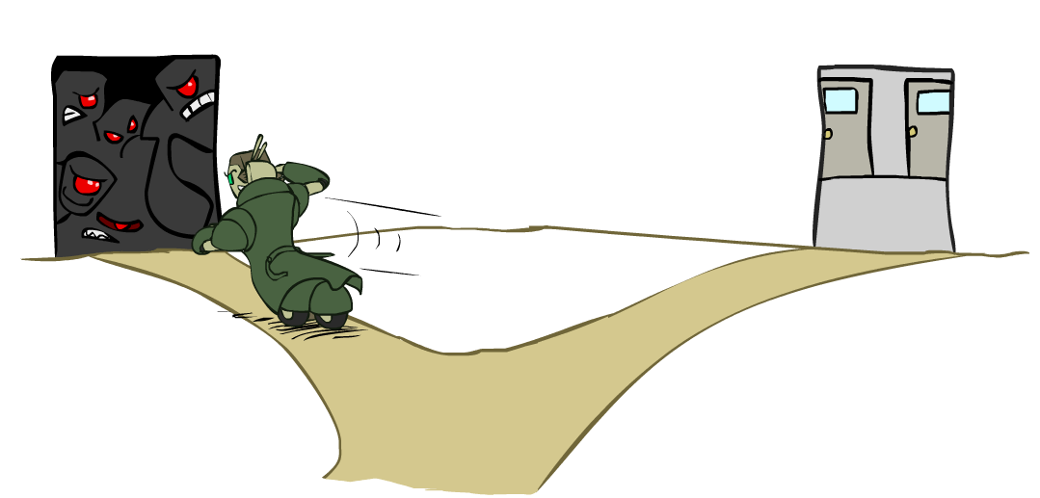
Ordering: Minimum Remaining Values
Variable Ordering: Minimum remaining values (MRV):
Choose the variable with the fewest legal left values in its domain
Why min rather than max?
Also called “most constrained variable”
“Fail-fast” ordering
Notes:
You must assign a value to EVERY variable... so might as well do the hard ones first which might show failures quickly...
...so backtracking will be done before you get too deep into the search tree.
You need not use every VALUE... so try to pick values that are "least constraining"
Sometimes you assign a value to a variable and suddenly a bunch of variable domains shrinks as a result.
That might not be a good value to use.

Slide 43
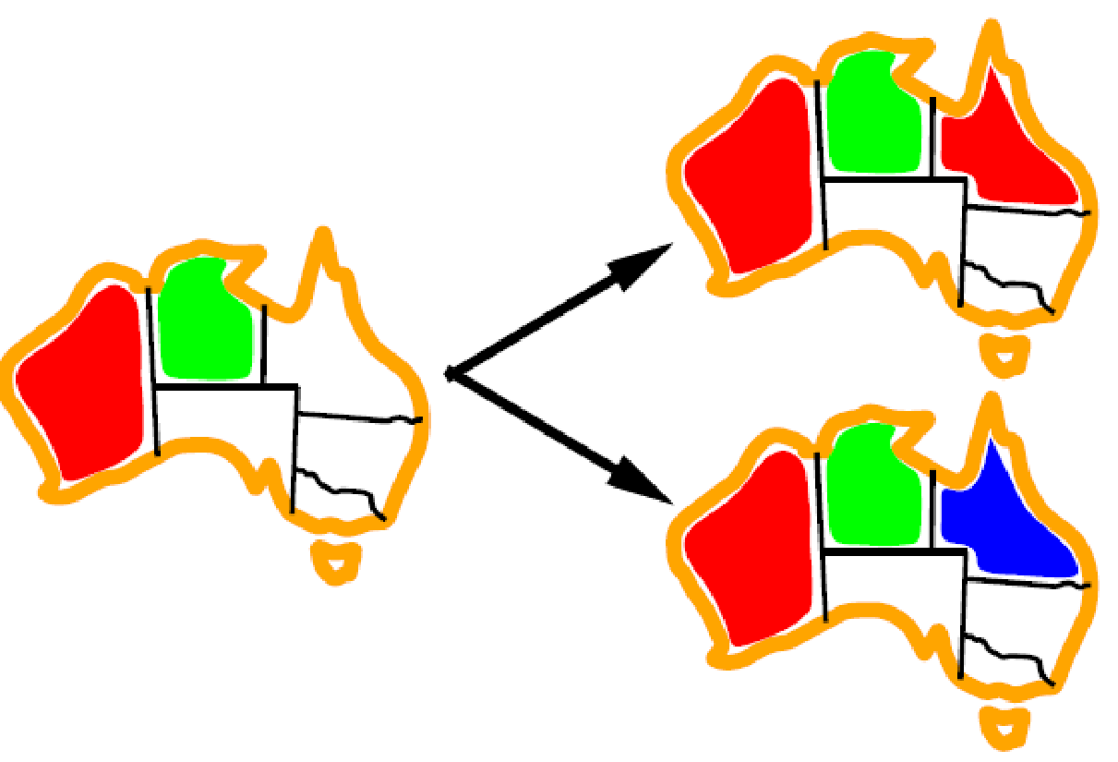
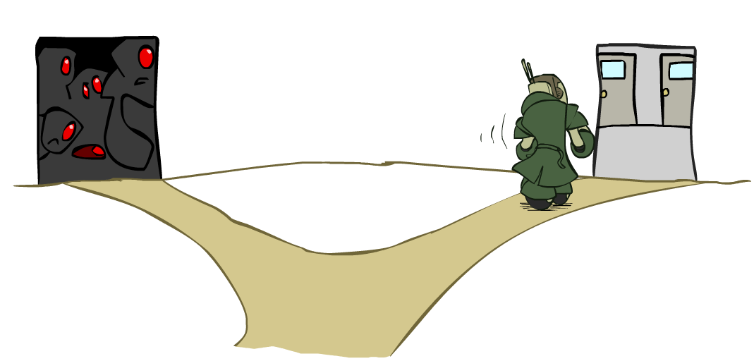
Ordering: Least Constraining Value
Value Ordering: Least Constraining Value
Given a choice of variable, choose the least constraining value
I.e., the one that rules out the fewest values in the remaining variables
Note that it may take some computation to determine this! (E.g., rerunning filtering)
Why least rather than most?
Combining these ordering ideas makes
1000 queens feasible
[Demo: coloring – backtracking + AC + ordering]
Notes:
Demo:
CS188 javascript demos -> source -> exercises -> csps -> CSPs demos -> CSPs demos.html
Settings:
Graph = Complex
Algorithm = Backtracking
Ordering = MRV
Filtering = Forward Checking
Solves already without any need for backtracking
Note: need a bigger problem to illustrate relevance of backtracking+AC+MRV+MCV

